Slide 1
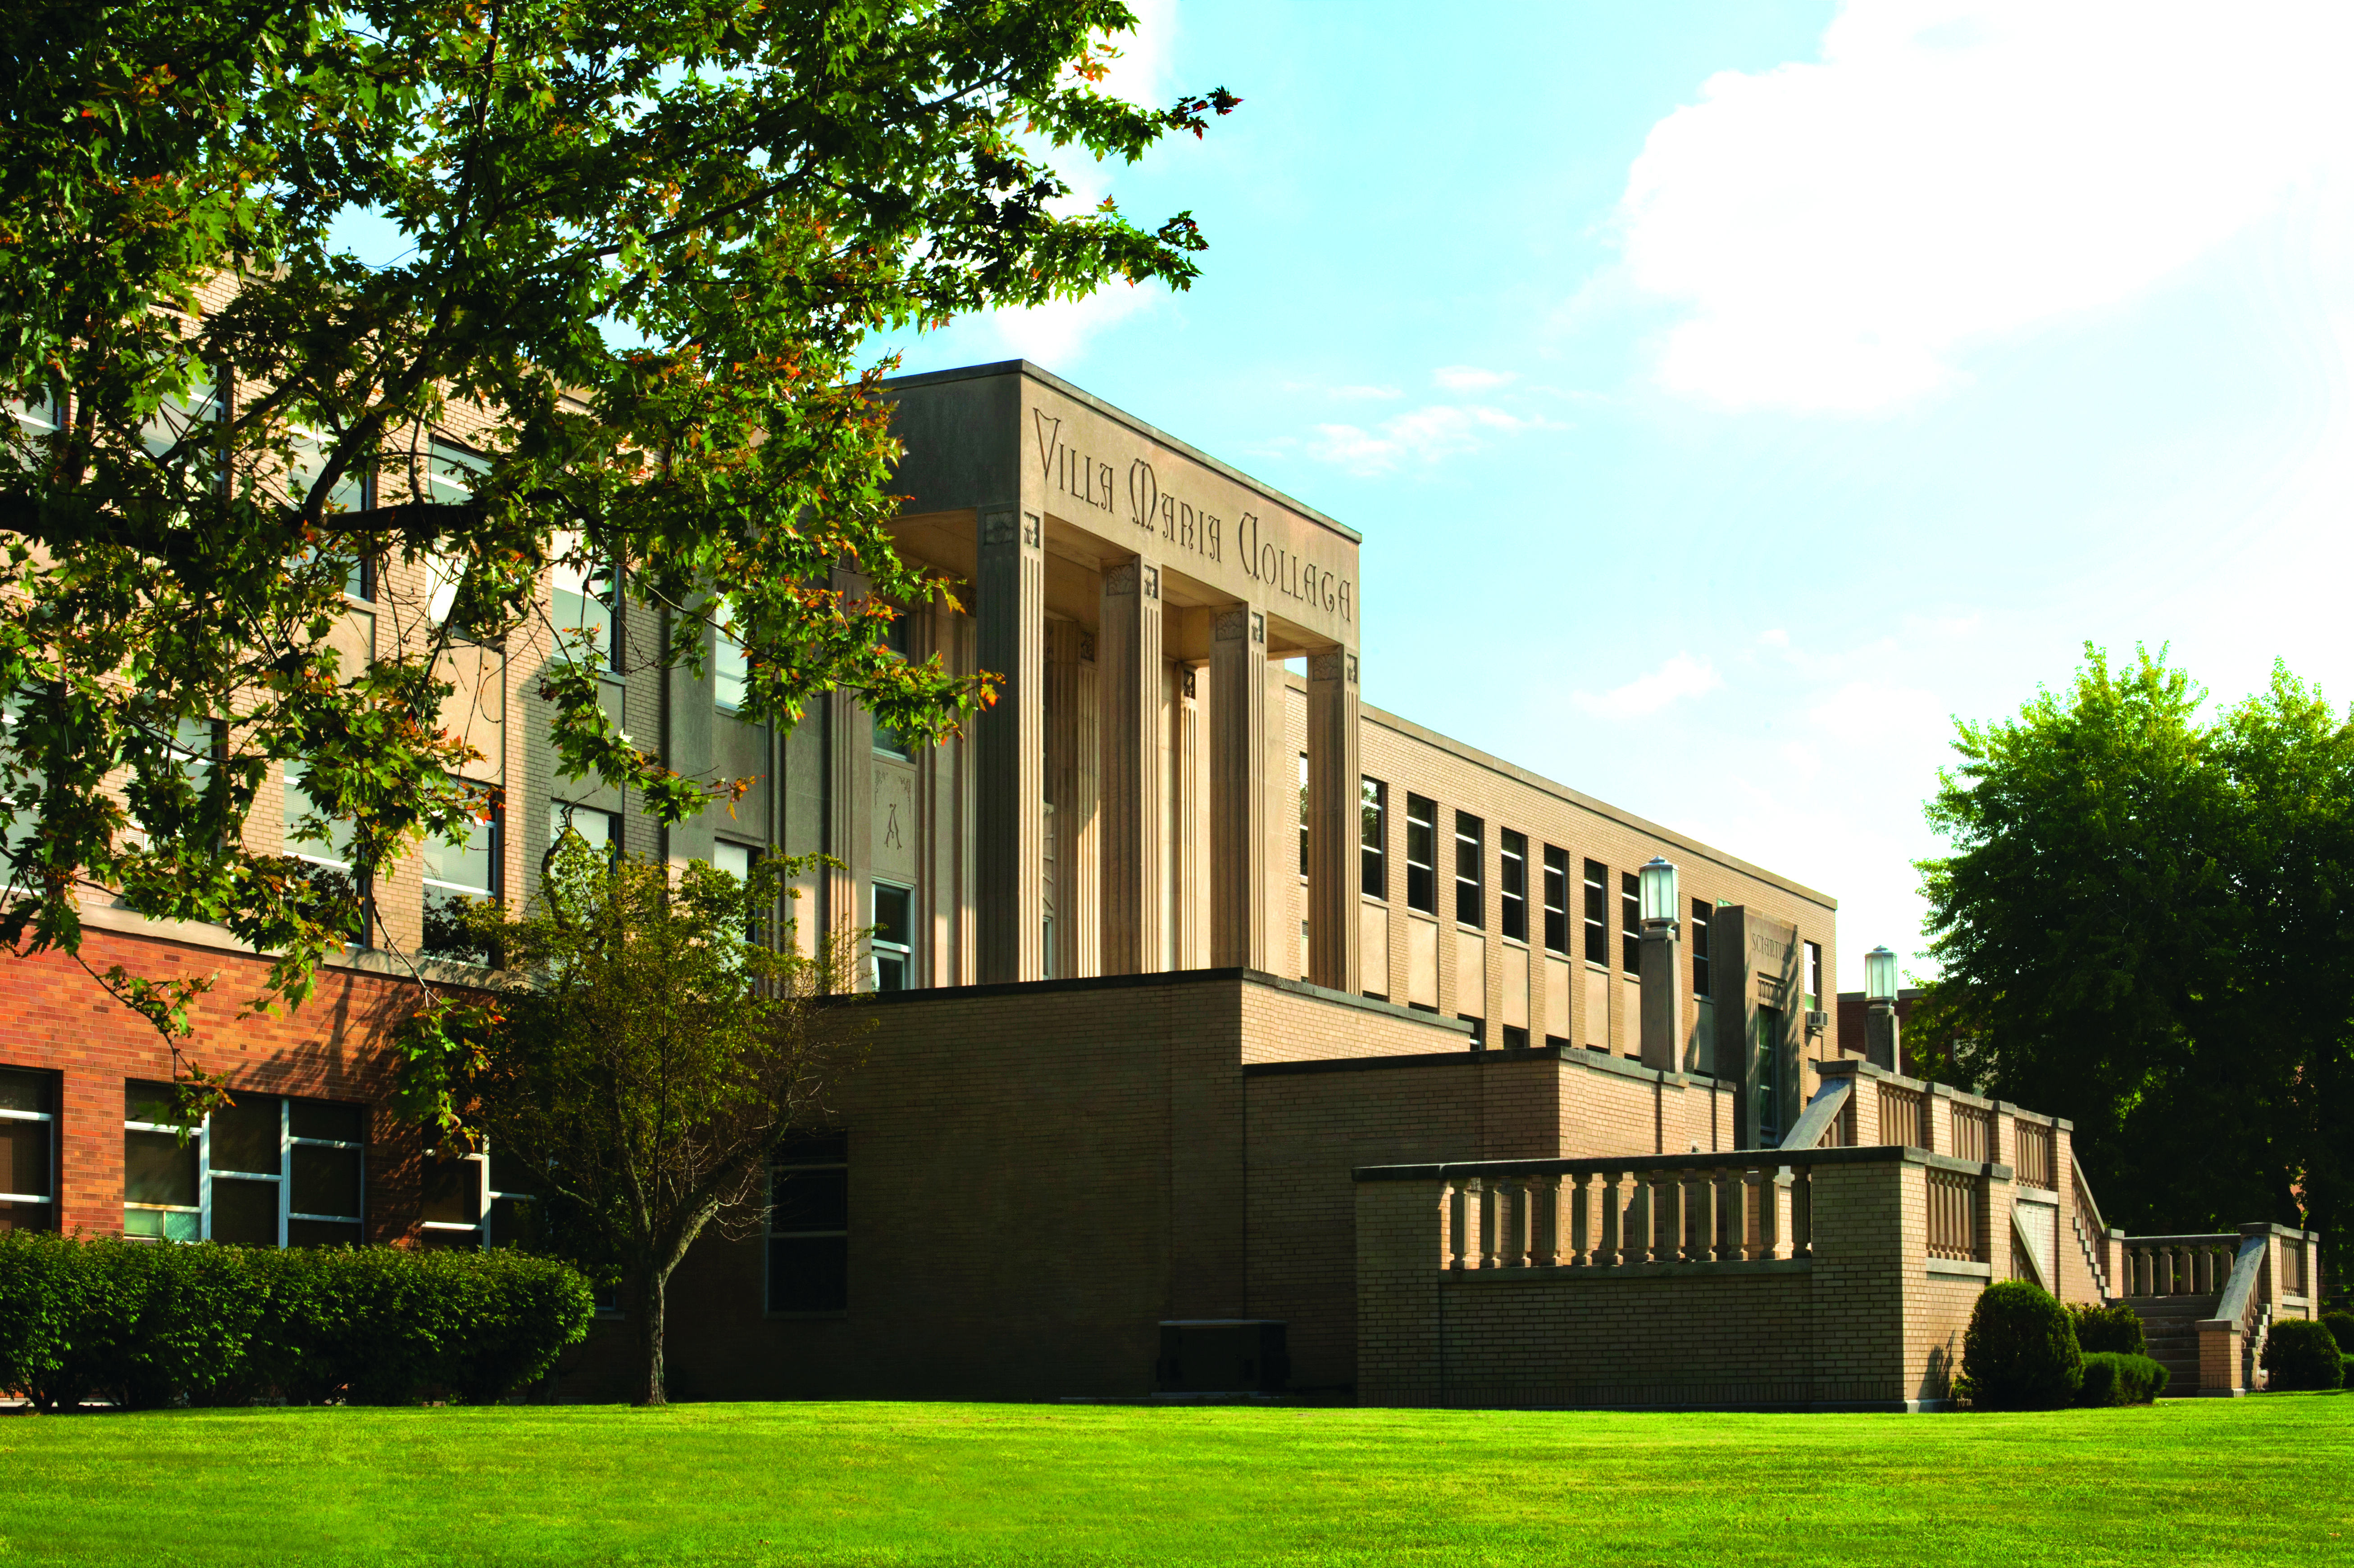

Oneida High School Virtual Visit
_________________________________________________________
Being Successful In Your College Search

Slide 2
April 25, 2014
Quick Facts:
As a small, private college focused on student success
3 departments: music, art, and liberal arts/professional studies
18 degree programs, including 12 bachelor degrees and 8 associate degrees
A diverse student body right around 550 students
Sept. 2020 US News & World Reports lists Villa as top colleges in the North not once, but twice. Ranked #43 overall, and #16 for Social Mobility.
A 9:1 student-faculty ratio
Internship requirements for all students, to help students gain critical real-world experience

Slide 3
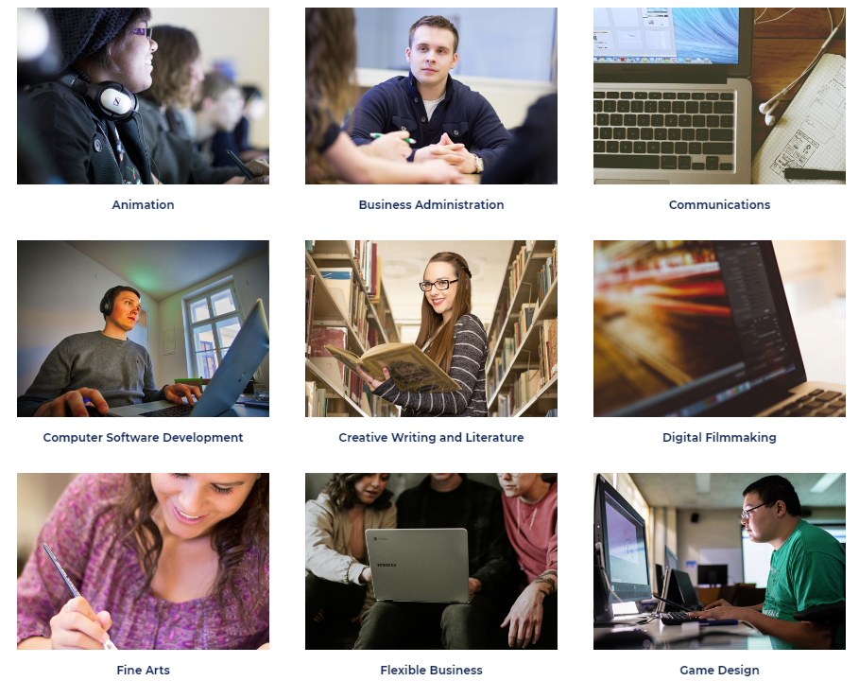
April 25, 2014
Our Programs

Slide 4
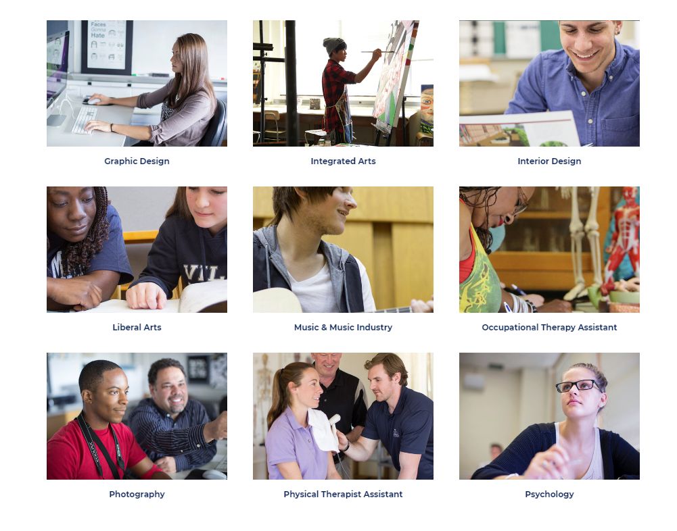
April 25, 2014
Our Programs

Slide 5
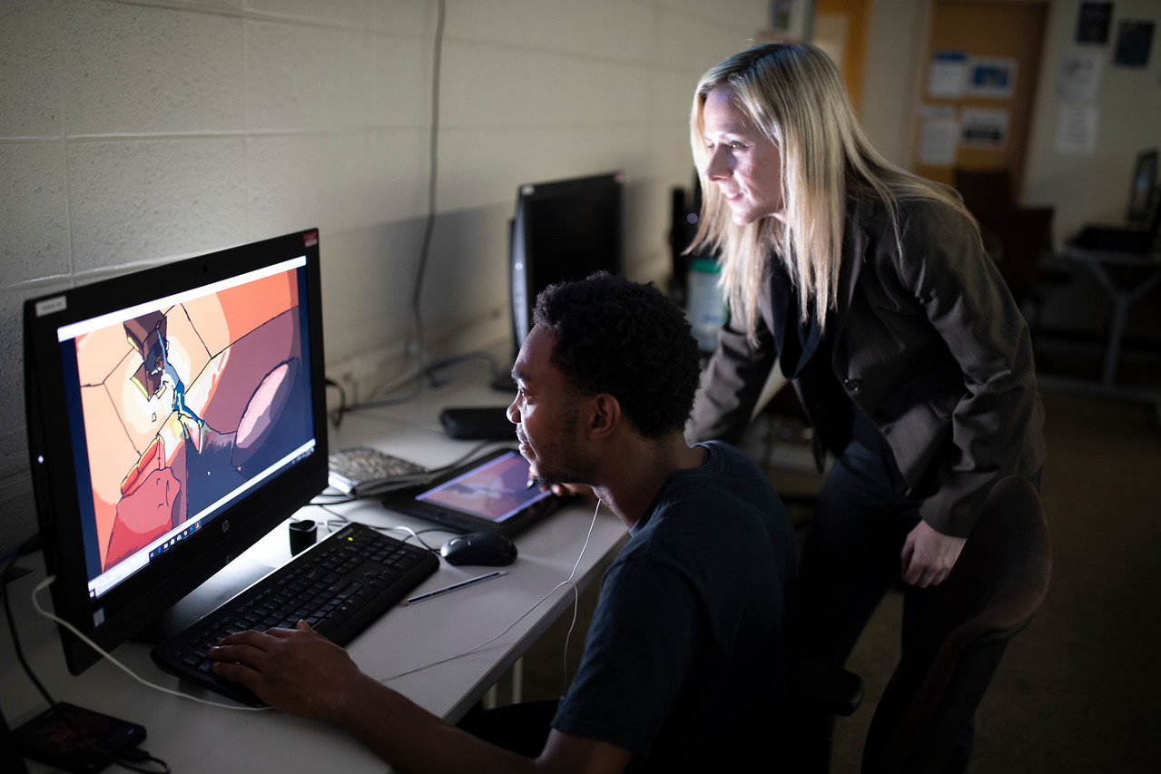
New Majors/Minors
Game Design
Computer Software Development
  Game Design Concentration
New Minors in Criminal Justice, Sports Management and Social Work

Slide 6

April 25, 2014
Game Design & eSports Team
Only College in Buffalo offering Game Design Degree
  Combination of Animation and Computer Software Development
  eSports Scholarships

Slide 7
Virtual Tour
Villa's Virtual Campus Tour

Slide 8
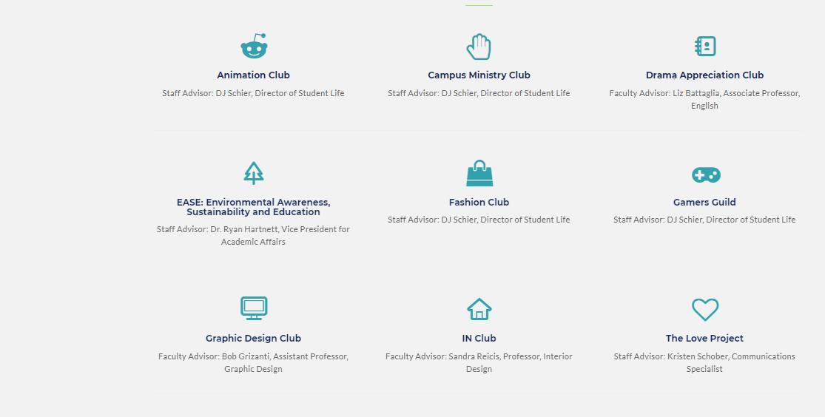
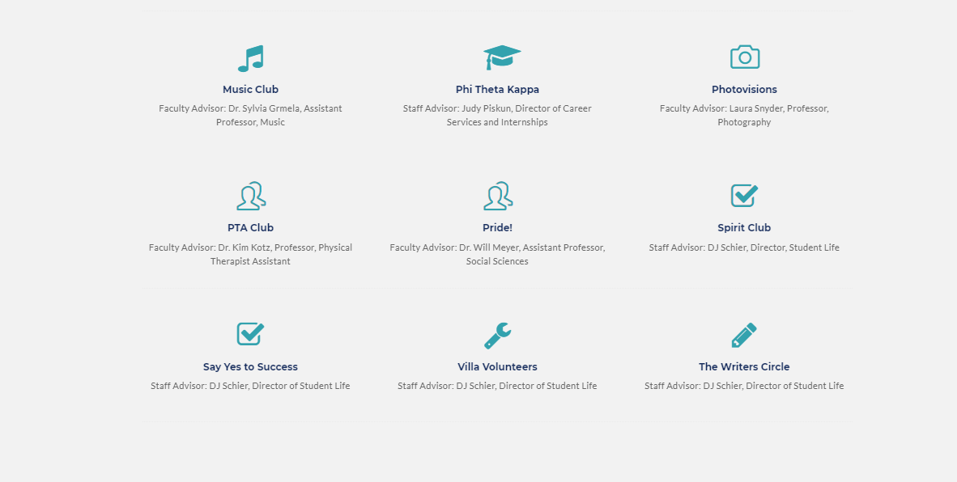
April 25, 2014
Student Life
Orientation Leaders
Student Government
Themed programming
Enriching trips and entertainment
18 student run clubs and organizations
  Academic and Social Clubs

Slide 9

Achieve Program at Villa Maria College
The Achieve Program provides specialized services to students with learning differences. At Villa, we look at students’ needs individually, and develop a plan to help ease their transition into college. Through the Achieve Program, students can build their confidence as they develop the skills that are critical for achieving academic and social successes at the collegiate level and beyond.
Designed for students with 504 plans and IEP’s.
Learn more at www.achieveatvilla.com

Slide 10
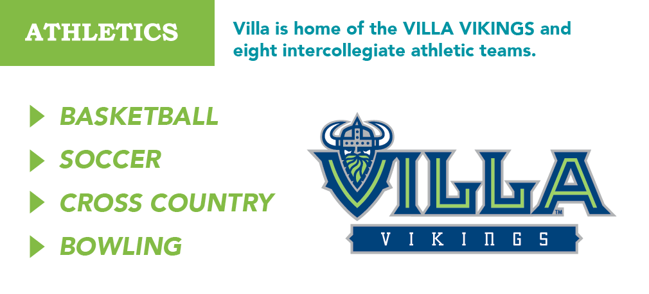
April 25, 2014
Sports
8 intercollegiate athletic teams that compete in the USCAA.
An updated athletic center that contains a regulation-sized basketball court, weight room, and brand new auxiliary gym

Slide 11
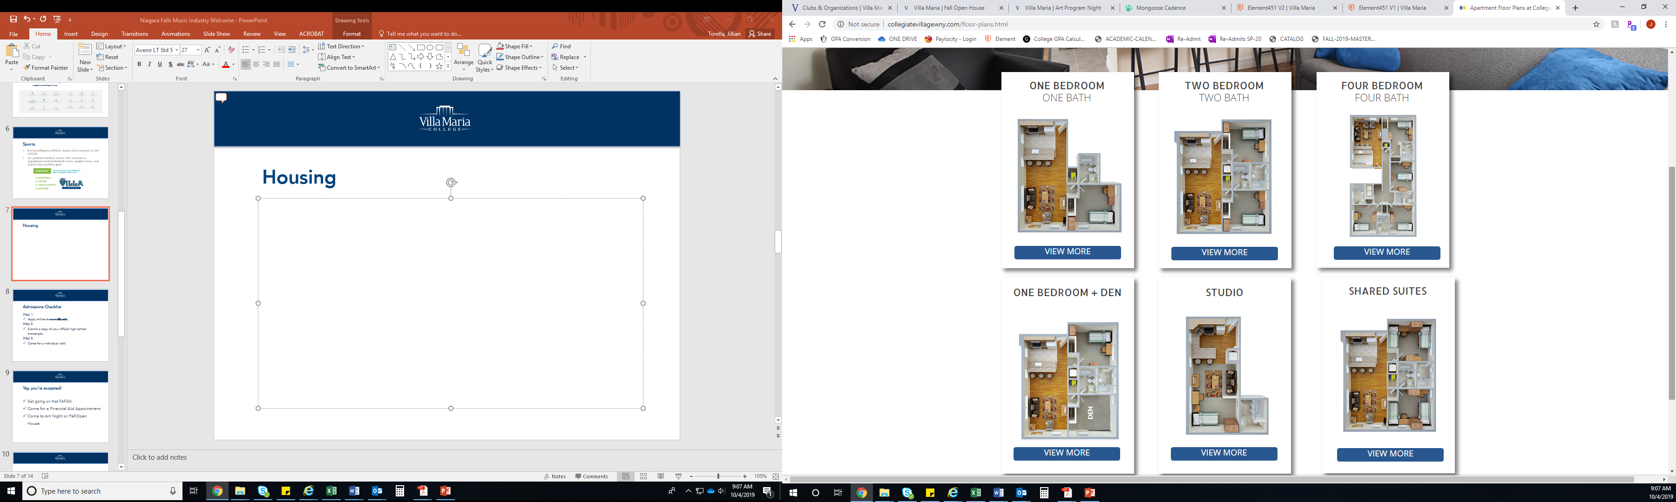
April 25, 2014
Housing
Collegiate Village
Use Financial Aid!
Dining Hall, in-ground pool, movie theater room, game room, gym
Free shuttle
Residential Life

Slide 12
April 25, 2014
Admissions Checklist
Step 1:
Apply online at www.villa.edu or use paper app.
Step 2:
Submit a copy of your official high school transcripts
Step 3:
Come for a individual visit!

Slide 13
April 25, 2014
Yay, you’re accepted!
Get going on that FAFSA!
Come for a Financial Aid Appointment
Come to Fall Open House Nov. 11th
9am – 3pm Socially distanced individual tours

Slide 14
April 25, 2014
Types of Villa Financial Aid
Merit Scholarships
  Honors Scholarship
  Presidential Scholarship
  Villa Merit Scholarship
  Talent-Based Scholarship

Slide 15
April 25, 2014
Types of Federal Financial Aid
*Based on Estimated Family Contribution
The FAFSA determines eligibility for:
PELL Grant
Supplemental Education
Opportunity Grant
Federal College Work Study
Subsidized Federal Direct Loan

Slide 16

Villa Maria College is proud to partner with:

Slide 17
Being Successful When Applying to Colleges
Don’t be afraid to ask questions
Keep appointments
Find the right fit for YOU
Smart Borrowing
Stay in contact with Admissions & Financial Aid Counselors

Slide 18
April 25, 2014
Stay Connected with us!
My name is Nathan Straus and you can email me at nstraus@villa.edu.
Follow us on Facebook, Twitter and Instagram
On-line chat with College representatives
Ability to text with prospective students
See upcoming special events, art exhibits, recitals, new programs announcements and more!

Slide 19



VILLA MARIA COLLEGE
MAY 22, 2014
THANK YOU!
__________________________________________

